Slide 1

Introduction to Pet Day Care Database Management
Discover how a comprehensive database system can revolutionize the operations and customer experience of your pet day care business. Leverage data-driven insights to streamline workflows, enhance pet care, and drive business growth.

Slide 2

Overview of Pet Day Care Services
For this database project, we are focusing on creating a comprehensive system for a pet day care service. Our goal is to provide a seamless experience for pet owners and ensure the well-being of their furry friends.
Within our pet day care, we offer various services tailored to meet the needs of pets and their owners. This includes supervised playtime in our spacious indoor and outdoor play areas, grooming and bathing services, and specialized diets and medication administration for pets with unique needs.
Our certified pet handlers create a nurturing and stimulating environment where pets can engage in interactive activities and socialization with other animals. The health and well-being of the pets are always our top priority.

Slide 3
Database Design Considerations
Designing an effective database for pet day care requires careful planning to ensure efficient data management and seamless operations. Key considerations include data organization, user access control, integration with existing systems, and scalability to accommodate future growth.
Identify critical data entities such as pet profiles, client information, service records, and staff management
Establish robust relationships between data entities to facilitate comprehensive reporting and analysis
Implement secure authentication and access privileges to protect sensitive pet and client data

Slide 4

Data Collection and Storage
1
Gathering Pet and Client Data
Comprehensive pet profiles with details like breed, age, medical history, and dietary needs. Detailed client information, including contact details, emergency contacts, and service preferences.
2
Secure Data Storage
Utilize a robust database solution to centralize and protect sensitive pet and client data. Implement robust access controls and encryption to safeguard information.
3
Integrated Record-Keeping
Seamlessly log service visits, grooming records, medication administration, and other pet care activities. Generate comprehensive reports and analytics to inform decision-making.

Slide 5
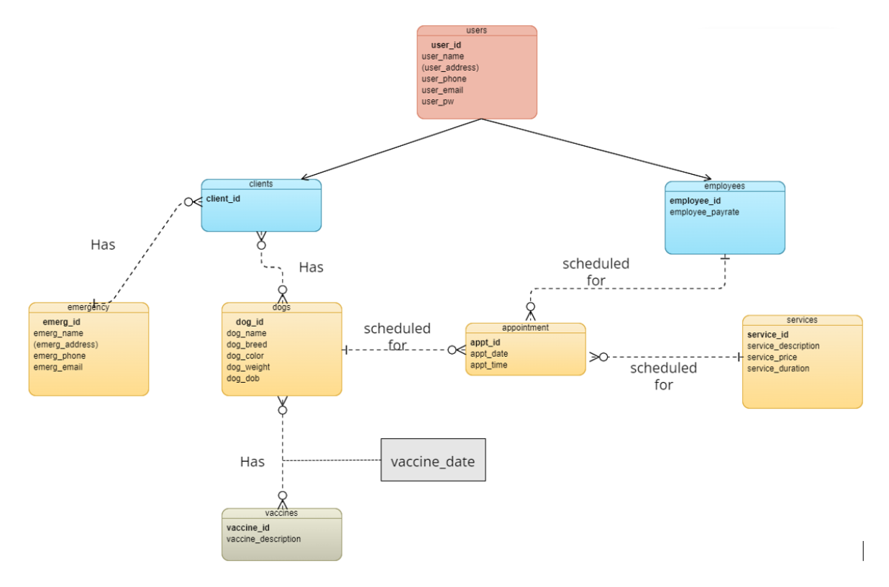
ER Diagram

Slide 6
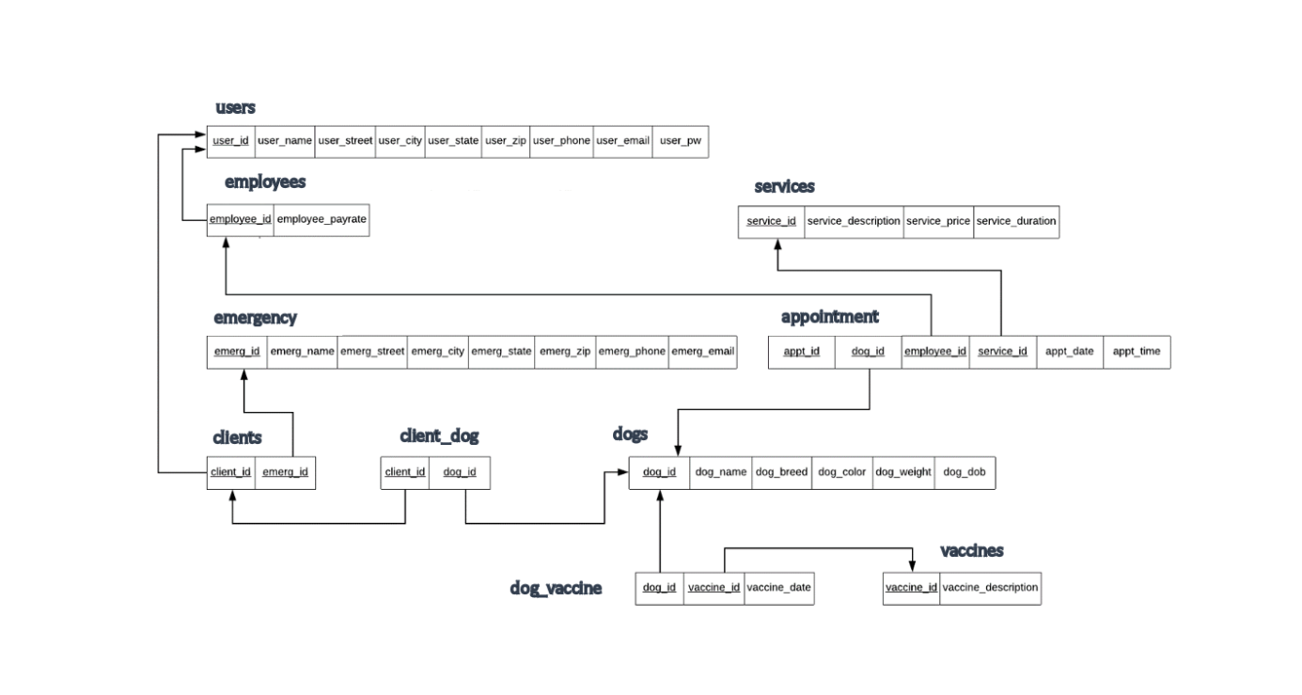
ER TO TABLE

Slide 7
EXECUTABLE OPERATIONS
Return dogs and their owners
Show all appointments
Show vaccine status for a particular dog
Return names of dogs less than a particular age

Slide 8
User Management and Access Control
Granular User Roles
Secure Authentication
Audit Trails
Remote Access Control
Maintain comprehensive audit logs that track user actions, including pet check-ins, medication administration, and updates to client or pet profiles. This provides accountability and helps identify potential security breaches.
Establish distinct user roles with tailored permissions, from administrative staff to pet handlers and front-desk personnel. Ensure each user can only access the data and functionalities relevant to their responsibilities.
Implement robust authentication methods, such as password policies, two-factor authentication, and secure login procedures. Protect sensitive information by granting access only to authorized users.
Enable secure remote access for authorized users, allowing managers and staff to manage pet day care operations from anywhere. Ensure data protection and compliance with industry standards.

Slide 9
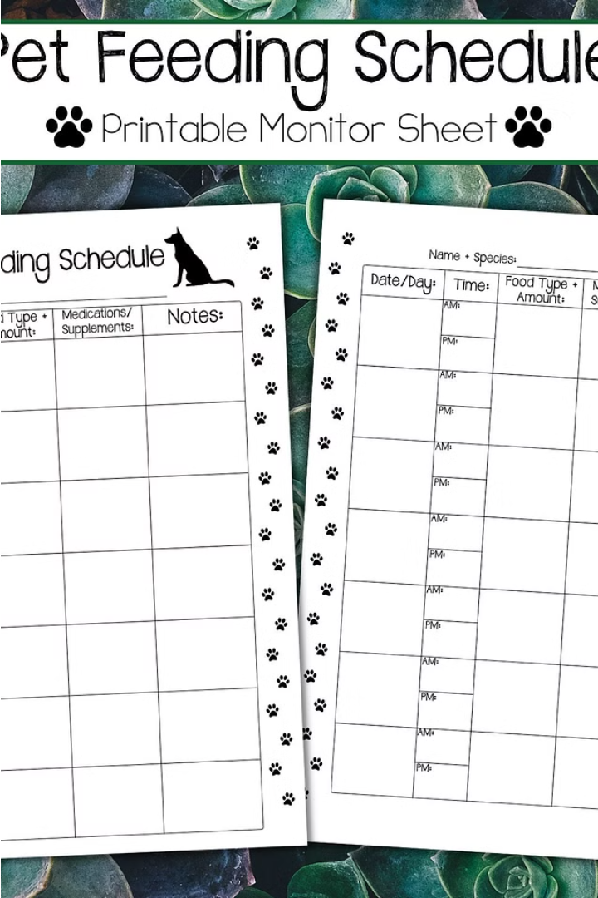
Scheduling and Appointment Booking
Our robust scheduling system ensures seamless booking and management of pet day care appointments. Clients can easily view available timeslots and reserve spots for their furry friends with just a few clicks.
Intuitive calendar tools allow our staff to efficiently coordinate pet check-ins, playtime, and pickup, while automated reminders keep clients informed of upcoming visits. Integration with our database ensures all pet and client information is accurately reflected in the schedule.

Slide 10
Security and Backup Strategies
Data Protection
Data Backup and Recovery
Implement measures to safeguard sensitive pet and client information stored in the database. Prioritize the privacy and confidentiality of data.
Regularly backup your database to ensure data availability and quick recovery in case of system failures or other unforeseen events.
Monitoring and Control
Access Management
Deploy systems to monitor and control database activity to mitigate potential risks and maintain data integrity.
Maintain appropriate access controls to protect information and ensure authorized usage of the database.

Slide 11
Conclusion and Future Enhancements
Ongoing Optimization
Expanded Integrations
Continuously refine and enhance the pet day care database system to adapt to evolving industry trends and client needs, ensuring maximum efficiency and customer satisfaction.
Explore integrations with third-party applications, such as pet medical records and online booking platforms, to provide a seamless, omnichannel experience for clients.
Predictive Analytics
Mobile Accessibility
Leverage advanced data analytics and AI-powered insights to forecast demand, optimize staffing, and anticipate client preferences, enabling proactive decision-making and continuous improvement.
Develop a responsive, mobile-friendly interface to allow clients and staff to access pet records, schedule appointments, and manage day care operations on-the-go.

